Slide 1
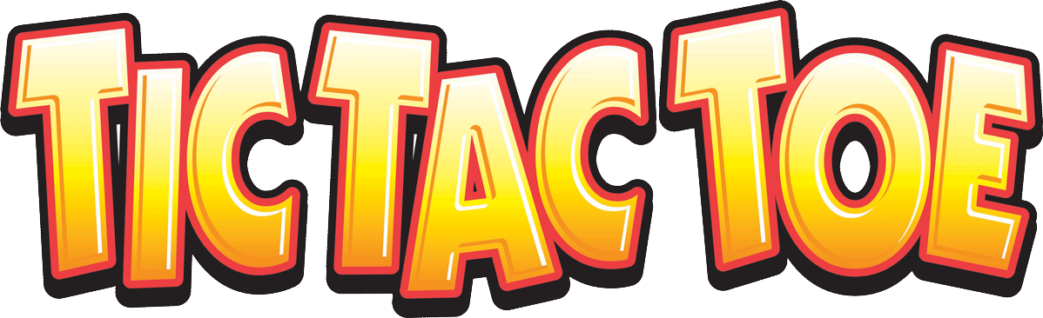
Group Members
Mahadev
Sharma
Rishabh
Verma
Madhav
Chadha
Ashni
Upadhyay
Rumneek
Kaur

Slide 2
Introduction
Tic-tac-toe also known as noughts and crosses or Xs and Os.
is generally a paper-and-pencil game for two players, X and O, who take turns marking the spaces in a 3×3 grid. The player who succeeds in placing three of their marks in a horizontal, vertical, or diagonal row wins the game.

Slide 3

Plan
Components
Source Code
Gathering resources
Working on software
Working on hardware
Assigning responsibilities
Preparing timeline
How to work according to the timeline
Meet ups

Slide 4
Meetups
Discussed availability of team members
Worked on advanced features
Gathered components like led’s and pushbuttons and started working on the code
Trouble shooting
Worked on code and hardware setup

Slide 5



Slide 6
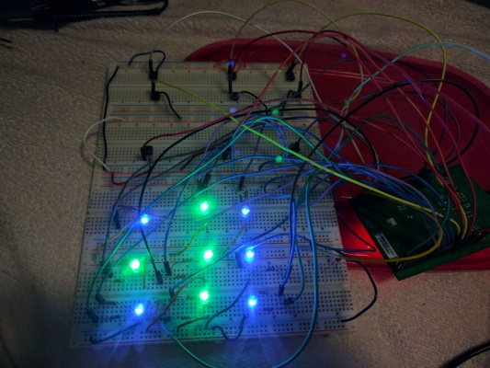
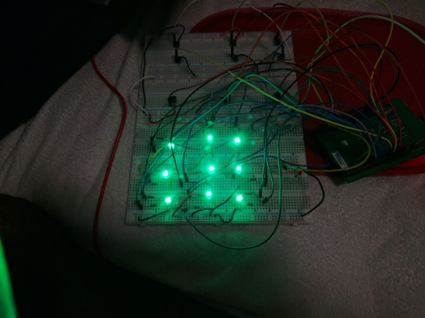
Challenges
Issues creating the correct logic.
Trouble setting up the hardware.
Issues creating logic for the win conditions.

Slide 7
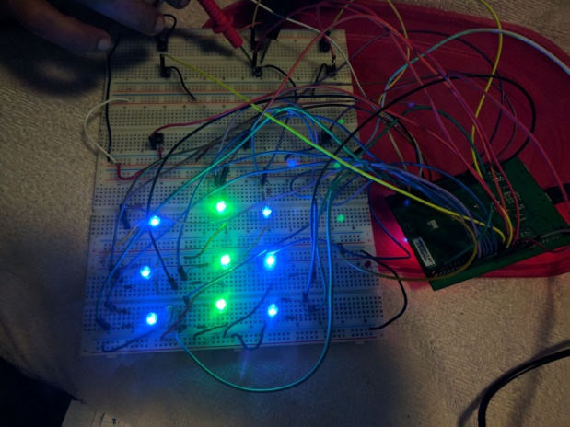
Continue….
Trouble with the led color.
Soldering issues.

Slide 8
Working Video

Slide 9


